Slide 1
Let the data talk - Visualizing data
Next Section

Slide 2
Let the data talk - Visualizing data
Section 5
Notes:
[Mandatory Slide] This would be the introduction slide of the topic that you are covering in this section.
When this slide plays, you could talk about the main aim that we’d be covering in this section.

Slide 3
In this section, we’ll look at:
Introduction to matplotlib and seaborn
Working with Distribution Plots
Using Categorical Plots
Using Matrix Plots
Formatting - Styling and Color
Notes:
This slide, like mentioned above is for multiple pointers. The information above covers the types of information that can be used in this slide

Slide 4
Introduction to matplotlib and seaborn
Notes:
[Mandatory Slide] This would be the introduction slide of the topic that you are covering in this subsection.
When this slide plays, you could talk about the main aim that we’d be covering in this video.

Slide 5
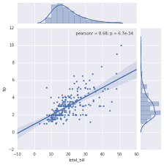

Python’s visualization abilities
Python offers a variety of packages for plotting data. This tutorial will use the following packages to demonstrate
Python's plotting capabilities:
Matplotlib
Seaborn

Slide 6
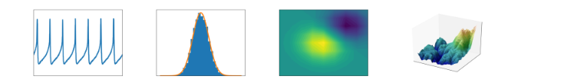
Matplotlib
Matplotlib is the "grandfather" library of data visualization with Python.
Can be used to create 2D and 3D graphs

Slide 7
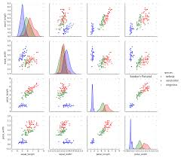
Seaborn
The seaborn package was developed based on the Matplotlib library.
It is used to create more attractive and informative statistical graphics. While seaborn is a different package, it can also be used to develop the attractiveness of matplotlib graphics.

Slide 8

Ggplot (in R) and Seaborn
Seaborn gives us the same overall feel and functionalities as that of R.

Slide 9
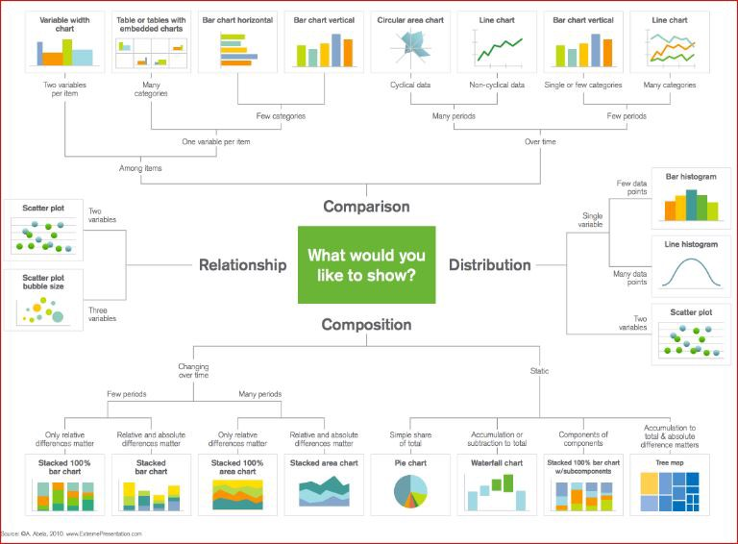

Slide 10
Working with Distribution Plots
Next Video
Notes:
[Mandatory Slide] This would be the slide of the next video that you will be covering.
When this slide plays, you could talk about the main aim that we’d be covering in the next video.

Slide 11
Working with Distribution Plots
Notes:
[Mandatory Slide] This would be the introduction slide of the topic that you are covering in this subsection.
When this slide plays, you could talk about the main aim that we’d be covering in this video.

Slide 12
In this video, we will talk about…
Creating Pandas DataFrames
Selecting Columns
Creating new columns
Removing columns
Selecting rows on the basis of index
Selecting rows on the basis of some condition

Slide 13
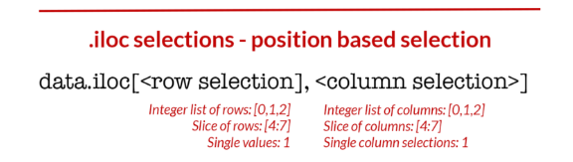
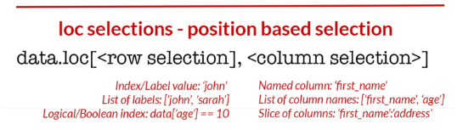
Better way of indexing in pandas

Slide 14
Using Categorical Plots
Next Video
Notes:
[Mandatory Slide] This would be the slide of the next video that you will be covering.
When this slide plays, you could talk about the main aim that we’d be covering in the next video.

Slide 15
Using Categorical Plots
Notes:
[Mandatory Slide] This would be the introduction slide of the topic that you are covering in this subsection.
When this slide plays, you could talk about the main aim that we’d be covering in this video.

Slide 16
Using Matrix Plots
Next Video
Notes:
[Mandatory Slide] This would be the slide of the next video that you will be covering.
When this slide plays, you could talk about the main aim that we’d be covering in the next video.

Slide 17
Using Matrix Plots
Notes:
[Mandatory Slide] This would be the introduction slide of the topic that you are covering in this subsection.
When this slide plays, you could talk about the main aim that we’d be covering in this video.

Slide 18
Formatting - Styling and Color
Next Video
Notes:
[Mandatory Slide] This would be the slide of the next video that you will be covering.
When this slide plays, you could talk about the main aim that we’d be covering in the next video.

Slide 19
Formatting - Styling and Color
Notes:
[Mandatory Slide] This would be the introduction slide of the topic that you are covering in this subsection.
When this slide plays, you could talk about the main aim that we’d be covering in this video.

Slide 20
In this video, we will talk about…
Concatenating
Merging
Joining

Slide 21
Concatenating
The concat() function (in the main pandas namespace) does all of the heavy lifting of performing concatenation operations along an axis while performing optional set logic (union or intersection) of the indexes (if any) on the other axes

Slide 22
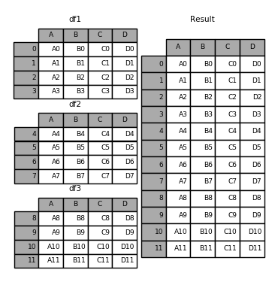
Concatenation

Slide 23
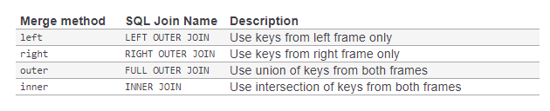
Merging- “how”

Slide 24
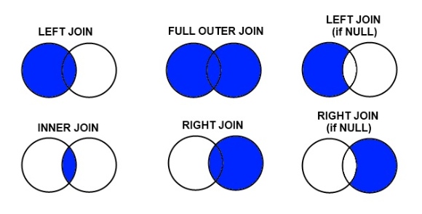
Types of Joins

Slide 25
Data Input and Output
Notes:
[Mandatory Slide] This would be the introduction slide of the topic that you are covering in this subsection.
When this slide plays, you could talk about the main aim that we’d be covering in this video.

